Slide 1
SOFT TISSUE TUMOURS Dr. R.S.G.SOWMYA, Assistant Professor Dept of Pathology, SKHMC, kulasekharam

Slide 2
Definition
Mesenchymal proliferations that occur in the extraskeletal, nonepithelial tissues of the body, excluding the viscera, coverings of the brain, and lymphoreticular system.

Slide 3
Tumors of adipose tissue
Lipomas
Liposarcoma
Tumors and tumor-like lesions of fibrous tissue
Nodular fasciitis,
Fibromatoses
Superficial fibromatoses
Deep fibromatoses
Fibrosarcoma

Slide 4
Fibrohistiocytic tumors
Fibrous histiocytoma
Dermatofibrosarcoma protuberans
Malignant fibrous histiocytoma
Tumors of skeletal muscle
Rhabdomyoma
Rhabdomyosarcoma

Slide 5
Vascular tumors
Hemangioma
Lymphangioma
Hemangioendothelioma
Hemangiopericytoma
Angiosarcoma

Slide 6
Peripheral nerve tumors
Neurofibroma
Schwannoma
Granular cell tumor
Malignant peripheral nerve
sheath tumors

Slide 7
Tumors of uncertain histogenesis
Synovial sarcoma
Alveolar soft part sarcoma
Epithelioid sarcoma

Slide 8
LIPOMA
Benign tumors of fat, known as lipomas, are the most common soft tissue tumor of adulthood.

Slide 9
MORPHOLOGY.
The conventional lipoma, the most common subtype, is a well-encapsulated mass of mature adipocytes that varies considerably in size. It arises in the subcutis of the proximal extremities and trunk, most frequently during mid-adulthood. Infrequently, lipomas are large, intramuscular, and circumscribed.

Slide 10
Histologically, they consist of mature fat cells with no evidence of pleomorphism or abnormal growth.
Lipomas are soft, mobile, and painless (except angiolipoma) and are usually cured by simple excision.

Slide 11
Liposarcoma
Liposarcomas are one of the most common sarcomas of adulthood and appear in the forties to sixties; they are uncommon in children. They usually arise in the deep soft tissues of the proximal extremities and retroperitoneum and are notorious for developing into large tumors.

Slide 12
MORPHOLOGY.
Histologically, liposarcomas can be divided into well-differentiated, myxoid, round cell, and pleomorphic variants. The cells liposarcomas are readily recognized as lipoblasts, which mimic fetal fat cells

Slide 13
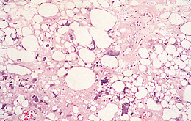

Slide 14
Fibrous tumours and Fibrohistiocytic tumours
Fibromatoses
SUPERFICIAL FIBROMATOSIS (PALMAR, PLANTAR, AND PENILE FIBROMATOSES)
Palmar, plantar, and penile fibromatoses, more bothersome than serious lesions, constitute a small group of superficial fibromatoses. They are characterized by nodular or poorly defined fascicles of mature-appearing fibroblasts surrounded by abundant dense collagen.

Slide 15
Immunohistochemical and ultrastructural studies indicate that many of these cells are myofibroblasts
Examples: Dupuytren contracture, plantar fibromatosis

Slide 16
DEEP-SEATED FIBROMATOSIS (DESMOID TUMORS)
Biologically, deep-seated fibromatoses lie in the interface between exuberant fibrous proliferations and low-grade fibrosarcomas. On the one hand, they present frequently as large, infiltrative masses that may recur after incomplete excision, and on the other, they are composed of banal well-differentiated fibroblasts that do not metastasize.

Slide 17
Fibrosarcoma
Fibrosarcomas are rare but may occur anywhere in the body, most commonly in the retroperitoneum, the thigh, the knee, and the distal extremities.

Slide 18
MORPHOLOGY.
Typically, these neoplasms are unencapsulated, infiltrative, soft, fish-flesh masses often having areas of hemorrhage and necrosis. Better-differentiated lesions may appear deceptively encapsulated.

Slide 19
Histologic examination discloses all degrees of differentiation, from slowly growing tumors that closely resemble cellular fibromas sometimes having spindled cells growing in a herringbone fashion to highly cellular neoplasms dominated by architectural disarray, pleomorphism, frequent mitoses, and areas of necrosis.

Slide 20
TUMORS OF SKELETAL MUSCLE
Skeletal muscle neoplasms, in contrast to other groups of tumors, are almost all malignant. The benign variant, rhabdomyoma, is distinctly rare.
Rhabdomyosarcoma
Rhabdomyosarcomas, the most common soft tissue sarcomas of childhood and adolescence, usually appear before age 20. They may arise in any anatomic location, but most occur in the head and neck or genitourinary tract.

Slide 21
MORPHOLOGY.
Rhabdomyosarcoma is histologically subclassified into the embryonal, alveolar, and pleomorphic variants. The rhabdomyoblast--the diagnostic cell in all types--contains eccentric eosinophilic granular cytoplasm rich in thick and thin filaments. The rhabdomyoblasts may be round or elongate; the latter are known as tadpole or strap cells

Slide 22
TUMORS OF SMOOTH MUSCLE
Leiomyomas
Leiomyomas, the benign smooth muscle tumors, often arise in the uterus where they represent the most common neoplasm in women. Leiomyomas may also arise in the skin and subcutis from the arrector pili muscles found in the skin, nipples, scrotum, and labia (genital leiomyomas) and less frequently develop in the deep soft tissues.

Slide 23
They are usually not larger than 1 to 2 cm in greatest dimension and are composed of fascicles of spindle cells that tend to intersect each other at right angles. The tumor cells have blunt-ended elongated nuclei and show minimal atypia and few mitotic figures.

Slide 24
Leiomyosarcoma
Leiomyosarcomas account for 10% to 20% of soft tissue sarcomas. Most develop in the skin and deep soft tissues of the extremities and retroperitoneum. Microscopically, the lesion is composed of interlacing fascicles of mildly pleomorphic, spindle cells with blunt-ended nuclei and eosinophilic cytoplasm. Average mitotic rate was 3 per 10 hpf. Geographic areas of necrosis is present

Slide 25
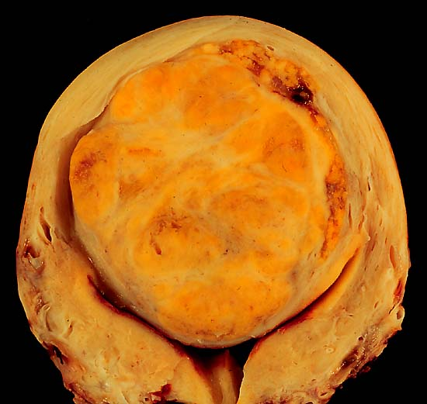
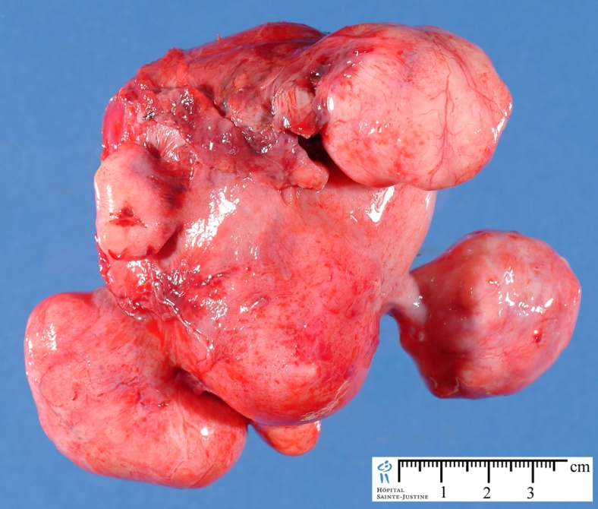
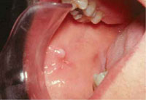
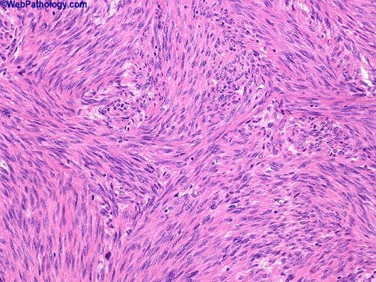

Slide 26
SYNOVIAL SARCOMA
Synovial sarcoma is so named because it was once believed to recapitulate synovium, but the cell of origin is still unclear. In addition, although the term synovial sarcoma implies an origin from the joint linings, less than 10% are intra-articular. Synovial sarcomas account for approximately 10% of all soft tissue sarcomas and rank as the fourth most common sarcoma.

Slide 27
MORPHOLOGY.
The histologic hallmark of synovial sarcoma is the biphasic morphology of the tumor cells (i.e., epithelial-like and spindle cells).
Immunohistochemistry is helpful in identifying these tumors, since the epithelioid and spindle cell portions yield positive reactions for keratin and epithelial membrane antigen, differentiating these tumors from most other sarcomas.

Slide 28
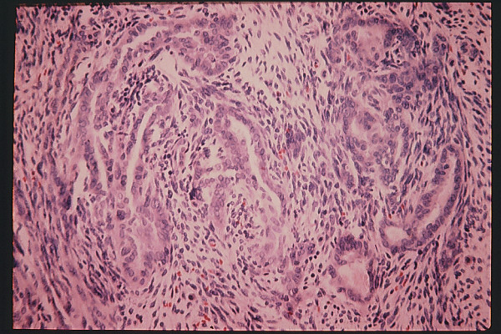

Slide 29
Reference
Harsh Mohan Text Book of Pathology
Robbins & Cotran Pathologic Basis of Disease

